Slide 1
Touch Typing Course Part 2

Slide 2

Content
After finish the lesson student will be able to:
Typing without watching their keyboard smoothly from letter A-Z
Keys R and U
Keys T and O

Slide 3
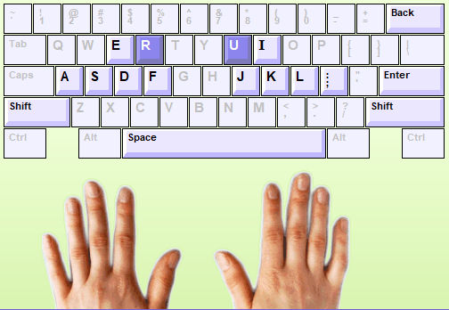
Keys R and U
The keys R and U located above the home row, on the “extension” row. R and U are typed using the Index fingers.
Notes:
Desktop can’t move during using because no power supply
Laptop can move to everywhere because it has power supply

Slide 4
Practice
1). Turn on your computer
2). Login into Typing Master with your account
3). Start to typing on “lesson three= Keys R and U”
New keys R and U = 5min
Word drill = 5 min
Bubbles game = Max= 5min
Word drill = 5 min
Sentence drill= 5 min
Paragraph drill= 5 min
Lesson exam = 10min
Students follow with instruction from Teacher one by one.
Notes:
Let them do it

Slide 5
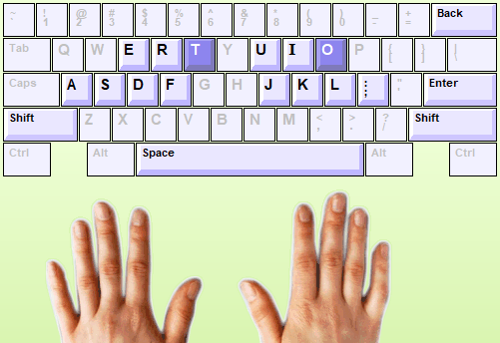
Keys T and O
The keys T and O located above the home row, on the “extension” row. T is typed using the left Index finger and O using the right ring finger.
Notes:
Desktop can’t move during using because no power supply
Laptop can move to everywhere because it has power supply

Slide 6
Practice
1). Continue to the next lesson Four “ Keys T and O”
2). Start to typing with instruction below:
New keys T and O = 5 min
Word drill = 5 min
Wordtris game = Max= 5min
Word drill = 5 min
Sentence drill= 5 min
Paragraph drill= 5 min
Lesson exam = 10min
Students follow with instruction from Teacher one by one.
Notes:
Let them do it

Slide 7
HOMEWORK
Student Need to finish home work both in chapter three and Four in Typing Master before next session by complete “ Lesson Exam”.
If you not complete, you can’t continue to the next chapter.
So it mean you need to qualify with speed in 10 min:
Less 15 wpm = 45 ( can’t continue)
15 wpm= 50
15-19 wpm= 50
20-24 wpm = 60
25-29 wpm = 70
30-34 wpm =80
35-39 wpm = 90
40 up wpm= 100
Note: Teacher can check all your record typing. Do your best!

Slide 8

Login to Typing Master by your account
Open lesson 4 “ Lesson Exam” in Typing Master
Your full score 40wpm= 100pts

Slide 9

Any Question ????

